Slide 1



GIFTED AND TALENTED
PROGRAM
ADVANCED ACADEMIC SERVICES
MISSION CISD

Slide 2


IDENTIFICATION PROCESS

Slide 3

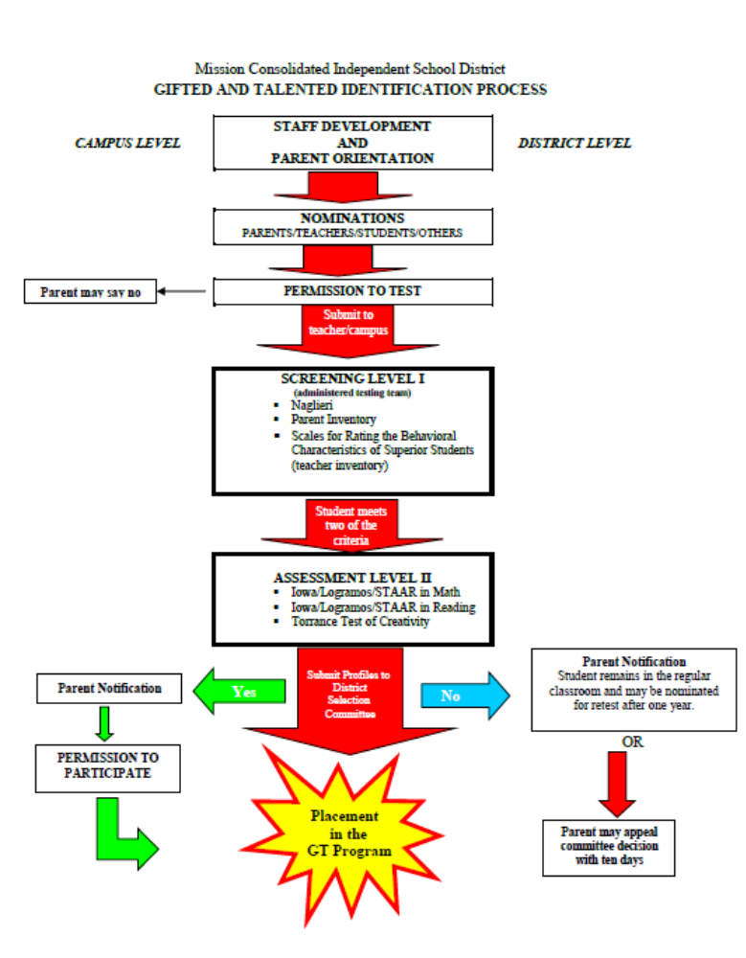


Identification Process:

Slide 4
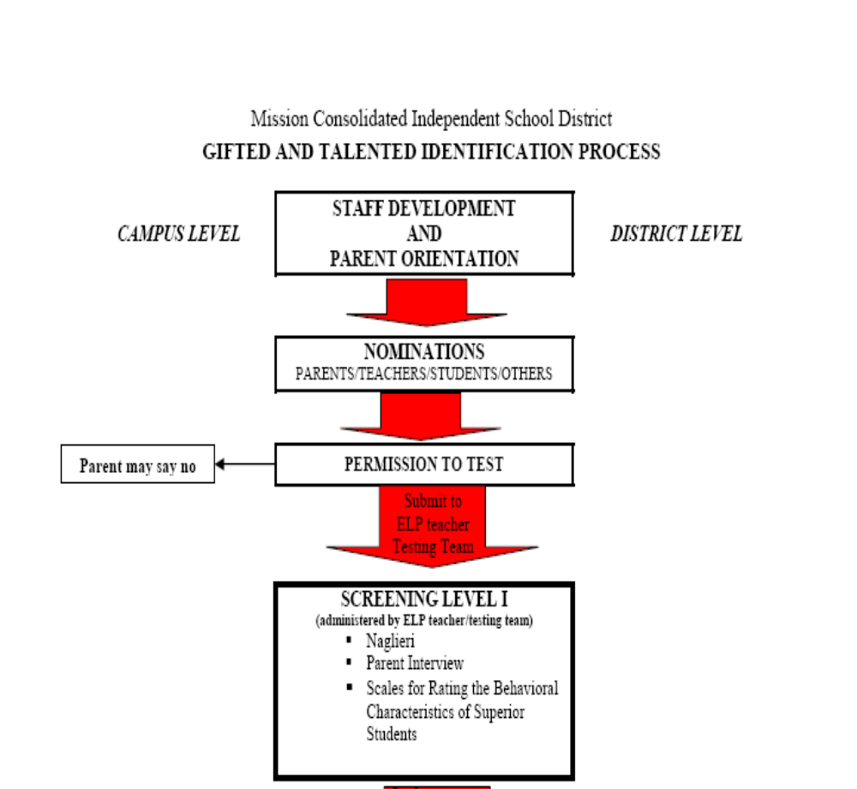
Phase I:

Slide 5
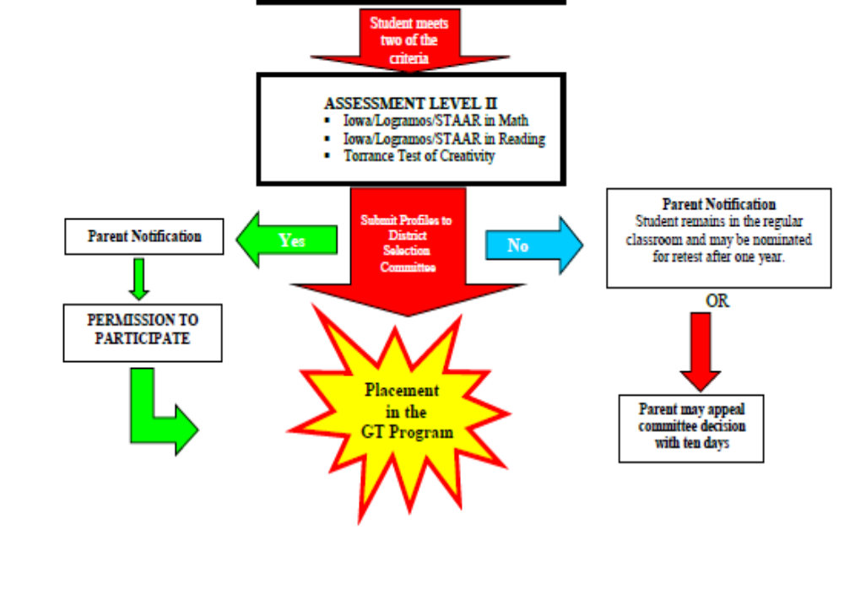

Phase II:

Slide 6
Important Dates
Kinder
  Nominations and Phase I Screening:
    January 8-19, 2018
  Phase II – Assessing:
    February 2018
  Services: Begin March 1, 2018
1st – 11th Grade
Nominations and
Phase I Screening:
    February 5-16,2018
Phase II – Assessing:
    March – May 2018
Services:
    Begin first day of school 2018-2019

Slide 7

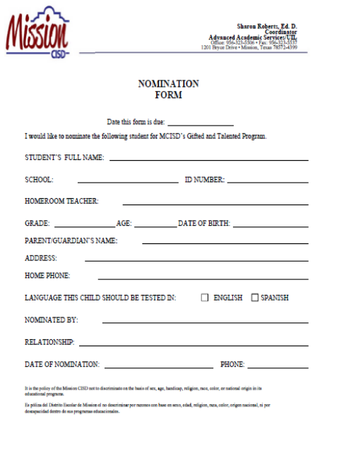
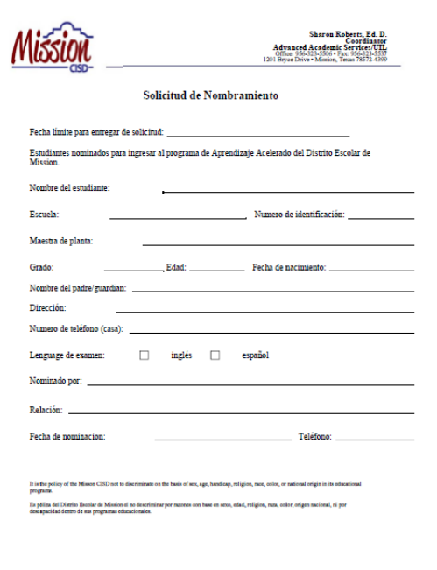
NOMINATIONS
Parents
Teachers
Students
Neighbors

Slide 8
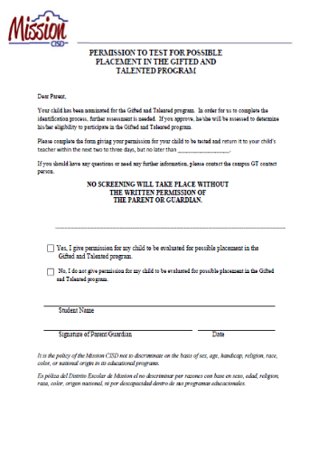
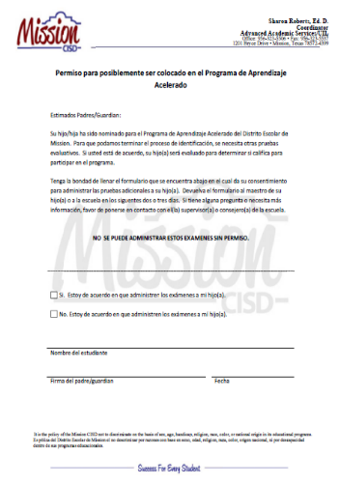
PERMISSION TO TEST
No testing will take place unless the parent or guardian provides written permission

Slide 9
SCREENING: PHASE I
Naglieri (90th percentile)
Parent Inventory (18/24)
Scales for Rating the Behavioral Characteristics of Superior Students (at or above the 90th percentile on 3 out of 4 criteria)
Students meeting two out of three of the above criteria proceed to Phase II.

Slide 10

SCREENING: PHASE II
Iowa/Logramos/STAAR
  Math
Iowa/Logramos/STAAR
  Reading
Torrance Tests of Creative Thinking (at or above the 90th percentile)

Slide 11
Identified Students
Committee meets to identify students as gifted and talented
      One secondary coordinator, one principal, two assistant principals, one IAS, one teacher
  Students meet four out of six criteria
  Parental permission must be given to enter the program

Slide 12
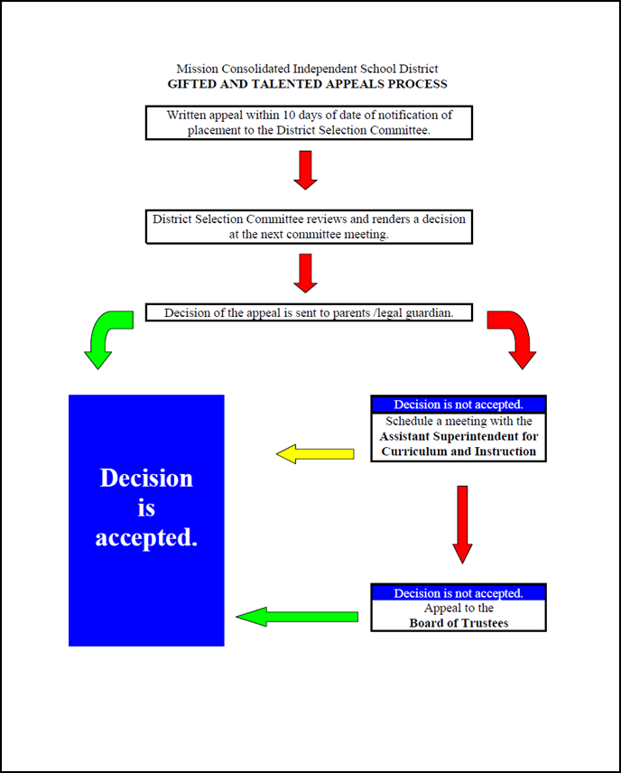
Appeals Process
Parents must appeal in writing within ten days of notification. Appeals are made to the Advanced Academic Services Office.
Appeals are presented to the District Selection Committee. Written record of the meeting is kept on file.

Slide 13

Appeals Process
If the parent is not satisfied with the Committee’s decision, the parent may request a conference with the Assistant Superintendent of Curriculum and Instruction within ten calendar days of receiving the Committee’s decision. A conference must be scheduled within two weeks of the request.
If the parent is not satisfied with the Assistant Superintendent’s decision, the parent may request to place the matter on the agenda of a future board meeting; this request must be in writing within seven calendar days.

Slide 14
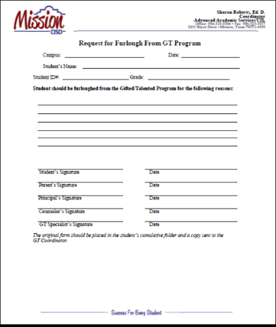
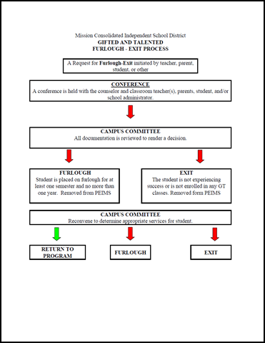

Furloughs
A furlough is a maximum of one year leave of absence from the Gifted and Talented Program for students who are unable to maintain satisfactory performance in the structure of the program due to extenuating circumstance.
A furlough may be requested by a student, parent, teacher, counselor, or administrator. The counselor must conference with the student prior to submission of the furlough form.

Slide 15

Re-entries
After a furlough, the student’s records will be reviewed to substantiate academic standing.
The student must be passing all core subjects with a 90 or above for elementary students. Students in the secondary must be passing the core area of strength with a 90 or above.

Slide 16
Re-entries
When a furlough is granted, the date of re-entry is specified on the form. Students failing to re-enter the program at the end of the furlough will be exited from the program and no longer identified as GT.
Once a student exits the GT Program, he/she must requalify to re-enter.
A school may not furlough or re-enter a student until the District Selection Committee provides clearance.

Slide 17
Exiting Students
After conferring with the students and his/her parents, the school committee may remove a student from the program if the program is no longer meeting the needs of the student.
Once a student has been exited from the program, he/she must be re-nominated and proceed through the screening and selection process.

Slide 18
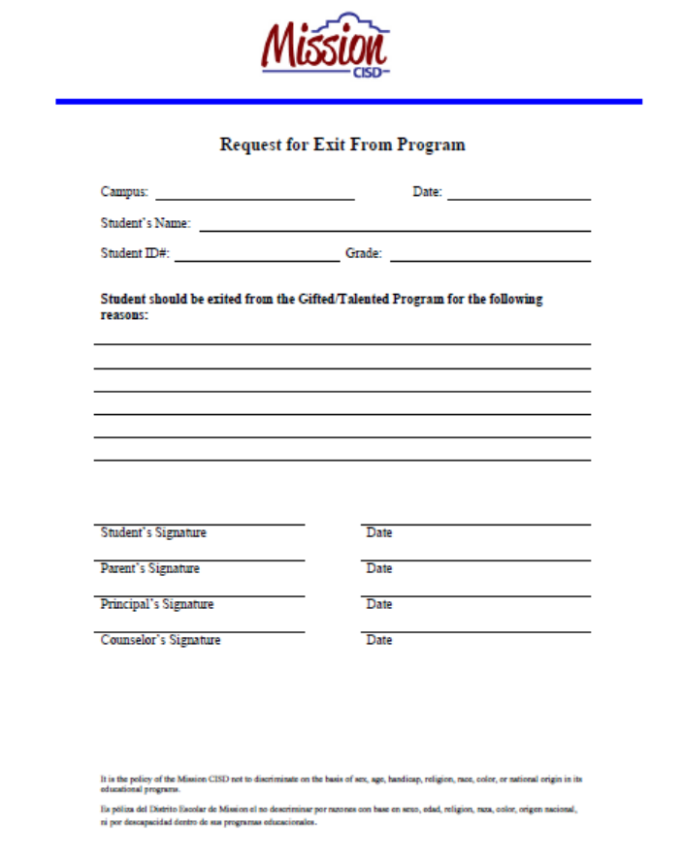
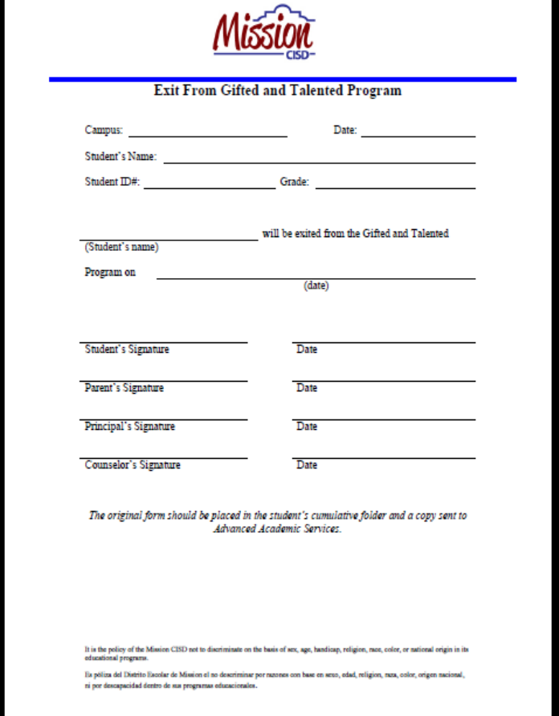
Exiting Students

Slide 19
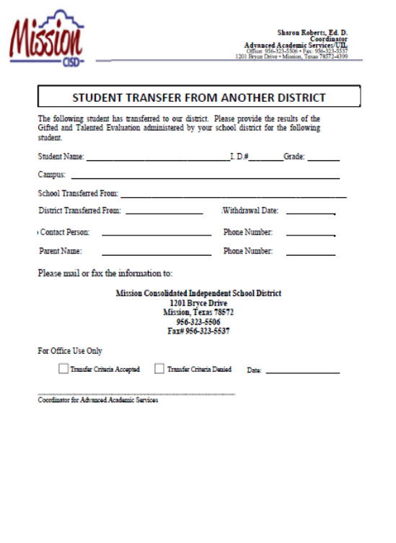

TRANSFERS INTO THE DISTRICT
When a student identified as gifted by another school district transfers into Mission CISD with proper documentation, the student’s profile sheet will be reviewed to determine whether or not the student meets Mission CISD’s criteria. If the student does not meet the district’s criteria, additional assessments may be administered during the first 6-weeks of school. After that, s/he may be nominated for screening and assessment for the GT program in the spring.

Slide 20


SERVICE DESIGN
    Elementary
  CLUSTER MODEL
    GT-Identified students are clustered in groups of three to five GT-identified students within a heterogeneous
    GT-identified students and students ready for advancement should be provided a differentiated curriculum in the four foundation areas, as well as creativity, leadership, and fine arts
    Junior High and High School
      PRE-AP/AP/DUAL PROGRAMS
        Non-Negotiables
        Teaching for Mastery
        RAFT writing
Important Dates
  October 6 Day of Design (http://globaldayofdesign.com/)
  September Texas Quiz Show – 4th and 7th Grades
  December 16 District History Fair
  February National History Day
  May 19 Advanced Academics Fair

Slide 21



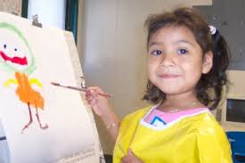


CURRICULUM AND INSTRUCTION
ELEMENTARY
Throughout the day and throughout the entire school year
GT students should be provided a differentiated curriculum in:
  The four foundation areas
  Creativity
  Leadership
  Fine arts
GT students should be provided opportunities to work
  In groups with like peers
  With other students
  Independently

Slide 22



2017-2018 Elementary GT Program
1ST COMPONENT:
Depth and Complexity/Differentiation: target questioning and answering during instructional time
  By 3rd 6-Weeks: students should be creating higher level questions in content areas, throughout lessons
    Students may challenge each other with their questions and answers
  Within each content area folder, resources are available:
    Roadmaps integrating Depth and Complexity Frames
    Depth and Complexity – Frames

Slide 23

Services for Gifted/Talented Students &
Advanced Learners
DURING THE SCHOOL DAY
2ND COMPONENT
ELEMENTARY CAMPUSES
Enrichment Period (Non-negotiable) – 35-minute daily enrichment
  Model:
    Each grade level “regroups” for 35 minutes per day
      GT: One teacher serves the GT-identified and students who do not need RtI…teachers may rotate by content area
      RtI: Other teachers work with students in RtI

Slide 24

Services for Gifted/Talented Students
& Advanced Learners
DURING THE SCHOOL DAY
ELEMENTARY
Enrichment Period (Non-negotiable) – 35-minute daily enrichment
2017-2018 Elementary GT Enrichment Period
  Year at a Glance and Enrichment Folders
      Folders by grade level
        Folders by Topic to be covered
          Monday - Math: Problem-Solver (1st-2nd) and Hands-on-Equations (3rd-5th)
          Tuesday – DI Instant Challenges (first 5-8 minutes only)
          Tuesday-Friday: JGB, Novels, STEAM, History Fair (December 16); Advanced Academics Fair (May 19)
          4th Grade – Texas Quiz Show

Slide 25


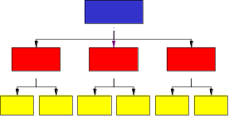




2017-2018 Elementary GT Program
Curriculum Writers trained teachers during district inservice days:
  1st Grade August 16 Sonia Salinas
  2nd Grade August 14 Sonia Salinas
  3rd Grade August 15 Julia Otken
  4th Grade August 16 Julia Otken
  5th Grade August 17 Rhonda Pena
    Engages ALL students in high-level thinking and learning
    Develops critical and creative thinking skills
    Challenges all students to become autonomous learners
    Develops deeper, more complex, and extensive understanding→→EXPERTS
present
past
future

Slide 26
SERVICE DESIGN: SECONDARY
JUNIOR HIGH
Pre-AP Program
  GT-Identified
  STAAR Scores
HIGH SCHOOL
Pre-AP/AP/Dual
  GT-Identified
  Open Enrollment
STC Dual Academies

Slide 27
Program Design: Elementary
Differentiated activities in all content areas aligned to the district curriculum
Reading/ELA
    Junior Great Books
    Novels
    Word of the Day/SAT Vocabulary
    Research Skills
    Thinking Skills
    Scamper
Math/Science
    Hands-on-Equations
    Kagan
    Engine-Uity
    Stemscopes
    Thinking Skills
    Scamper
    Depth and Complexity
Science/Social Studies
    Kagan
    Engine-Uity
    Thinking Skills
    Research Skills (IIM Method/Vowery Carlile Resources)
    Scamper
    Depth and Complexity
  Other
    TPSP
    Instant Challenges
  Extra-Curricular
    Destination Imagination
GT/Advanced Academics Fair
May 19, 2018, from 8:00 to 12:00
Location TBD

Slide 28
Services for Gifted/Talented Students
& Advanced Learners
DURING THE SCHOOL DAY
ELEMENTARY
CURRICULUM AND INSTRUCTION
College Readiness for ALL Students
ELEMENTARY
  College and Career Center at each campus (Counseling/Parental Involvement)
  Continue SAT Prep and Interactive Journals
    SAT Prep folder is located in the ELA folders in 2017-2018 ELA Folder
    Use Depth and Complexity in all core areas
  Continue DUKE TIP

Slide 29
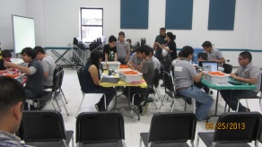
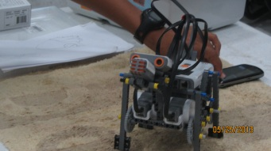

Program Design: Junior High Schools
Differentiated activities in all content areas aligned to the district curriculum
ELAR/Math/Science
Laying the Foundations/NMSI
Novels
Resources for TPSP
Social Studies
Novels
Videos
Extra-Curricular
Destination Imagination
Robotics
TexPrep
MathCounts
Science Bowl

Slide 30
Program Design: Junior High Schools
Courses offered for high school credit:
Algebra I and Geometry (must meet criteria)
Spanish and AP Spanish for college credit
Art
Theatre Arts
Keyboarding
Communication Applications
Health

Slide 31
Program Design: High Schools
Teachers at the secondary level who have completed the state required G/T training in addition to Pre-Advanced Placement and/or Advanced Placement Institute training utilize the cluster model to provide identified GT and high achieving students differentiated instruction in advanced coursework through Pre-AP and AP/Dual enrollment courses.
MCISD teachers who have a Masters degrees in content areas are able to teach college level dual courses through STC

Slide 32
Program Design: High Schools
GT and advanced students are served through:
    Pre-AP and AP Program
    Concurrent/Dual Enrollment
    TexPrep
    Masterminds
    Summer Reading
    Robotics
    Mock Trial

Slide 33
Advanced Academic Services
Department of Advanced Academic Services/UIL/College Readiness
http://www.mcisd.net/apps/pages/index.jsp?uREC_ID=217824&type=d
Dr. Sharon Roberts, Director
E-mail: sarobe24@mcisd.org
Ms. Adelina Alaniz, Coordinator
E-mail: aalaniz@mcisd.org
Ms. Cynthia Flores, Secretary
E-mail: cgflor04@mcisd.org
Office: (956) 323-5506
Fax: (956) 323-5537

Slide 34
Advanced Academic Services
Gifted and Talented Program
Pre-Advanced Placement Program/Advanced Placement Program
Dual Enrollment
Concurrent Enrollment
Dual Enrollment Academies with STC
Credit by Exam
Destination Imagination
UIL - Elementary
Robotics
TexPrep
Summer Reading
College Readiness Program
  PSAT 8, 10, 11
  ACT/SAT
College Readiness Classes
  AVID
  Gear Up
Duke TIP
MCISD Masters Programs and Teacher Tuition Reimbursement Programs
UT-Outreach
T-STEM
ECHS

Slide 35




“COMMITTED TO
EXCELLENCE”
PREPARING EVERY STUDENT FOR COLLEGE,
CAREERS. AND LIFE!
“SUCCESS FOR EVERY
STUDENT”

